Slide 1
Chapter7: IP Addressing
Introduction to Networks
Notes:
Cisco Networking Academy program
Introduction to Networks
Chapter 8: IP Addressing

Slide 2
Chapter 7
7.0 Introduction
7.1 IPv4 Network Addresses
7.2 IPv6 Network Addresses
7.3 Connectivity Verification
7.4 Summary
Notes:
Chapter 8 Sections

Slide 3
Chapter 7: Objectives
Upon completion of this chapter, you will be able to:
Describe the structure of an IPv4 address.
Describe the purpose of the subnet mask.
Compare the characteristics and uses of the unicast, broadcast, and multicast IPv4 addresses.
Compare the use of public address space and private address space.
Explain the need for IPv6 addressing.
Describe the representation of an IPv6 address.
Describe types of IPv6 network addresses.
Configure global unicast addresses.
Describe multicast addresses.
Describe the role of ICMP in an IP network. (Include IPv4 and IPv6.)
Use ping and traceroute utilities to test network connectivity.
Notes:
Chapter 8 Objectives

Slide 4
7.1 IPv4 Network Addresses
Notes:
8.1 IPv4 Network Addresses

Slide 5
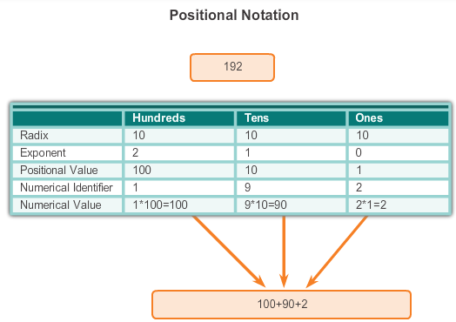
IPv4 Address Structure Binary Notation
Binary notation refers to the fact that computers communicate in 1s and 0s
Positional notation - converting binary to decimal requires an understanding of the mathematical basis of a numbering system
Notes:
8.1.1.1 Binary Notation

Slide 6

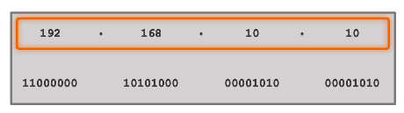


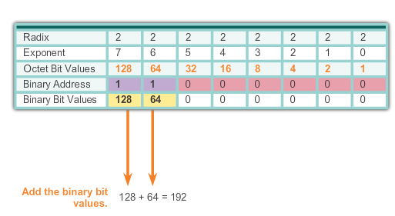
IPv4 Address Structure Binary Number System
Notes:
8.1.1.2 Binary Number System

Slide 7


IPv4 Address Structure Converting a Binary Address to Decimal
Practice
Notes:
8.1.1.3 Converting a Binary Address to Decimal

Slide 8
IPv4 Address Structure Converting a Binary Address to Decimal
Practice
Answer = 176
Answer = 255
Notes:
8.1.1.3 Converting a Binary Address to Decimal

Slide 9
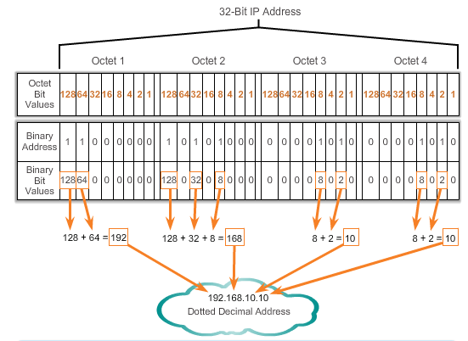
IPv4 Address Structure Converting a Binary Address to Decimal
Notes:
Section 8.1.1.3 & 8.1.1.4 Converting a Binary Address to Decimal

Slide 10
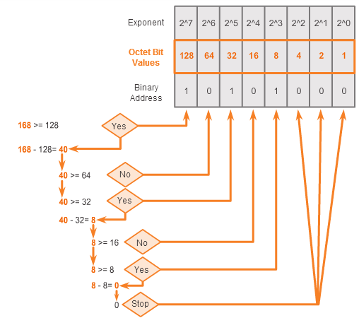
IPv4 Address Structure Converting from Decimal to Binary
168 = ? binary
Notes:
8.1.1.5 Converting from Decimal to Binary

Slide 11
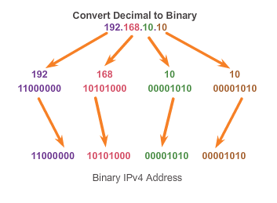
IPv4 Address Structure Converting from Decimal to Binary (Cont.)
Notes:
8.1.1.6 Converting from Decimal to Binary (Cont.)

Slide 12
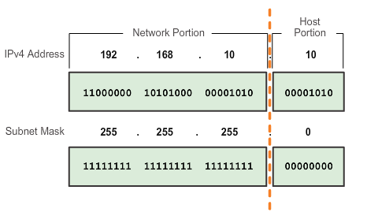
IPv4 Subnet Mask Network Portion and Host Portion of an IPv4 Address
To define the network and host portions of an address, a devices use a separate 32-bit pattern called a subnet mask
The subnet mask does not actually contain the network or host portion of an IPv4 address, it just says where to look for these portions in a given IPv4 address
Notes:
8.1.2.1 Network Portion and Host Portion of an IPv4 Address

Slide 13
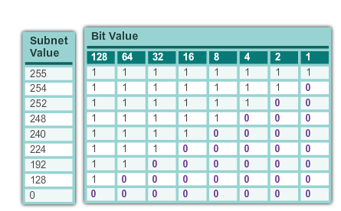
IPv4 Subnet Mask Network Portion and Host Portion of an IPv4 Address (cont.)
Valid Subnet Masks
Notes:
8.1.2.1 Network Portion and Host Portion of an IPv4 Address (cont.)

Slide 14
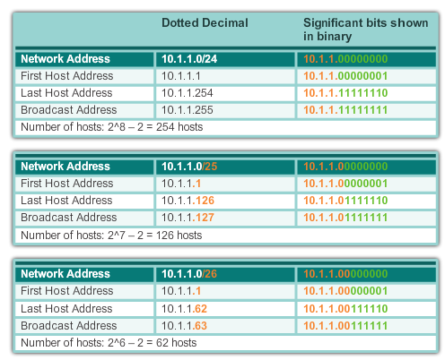
IPv4 Subnet Mask Examining the Prefix Length
Notes:
8.1.2.2 Examining the Prefix Length

Slide 15
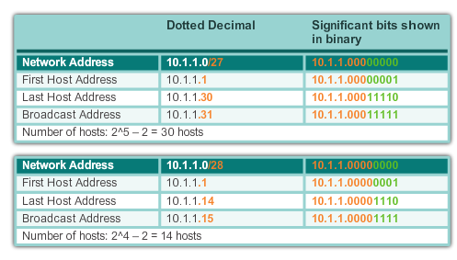
IPv4 Subnet Mask Examining the Prefix Length (cont.)
Notes:
8.1.2.2 Examining the Prefix Length (cont.)

Slide 16
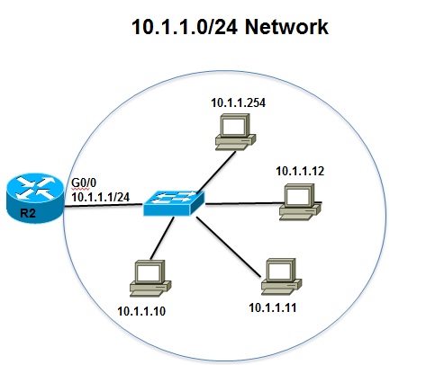
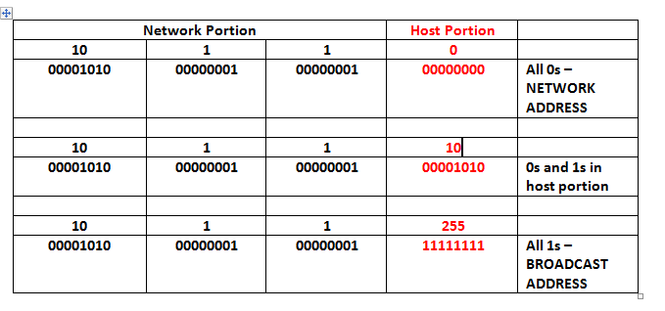
IPv4 Subnet Mask IPv4 Network, Host, and Broadcast Address
10.1.1.0/24
Notes:
8.1.2.3 IPv4 Network, Host and Broadcast Address

Slide 17
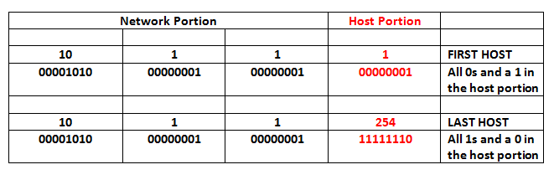
IPv4 Subnet Mask First Host and Last Host Addresses
10.1.1.0/24
Notes:
8.1.2.4 First Host and Last Host Addresses

Slide 18
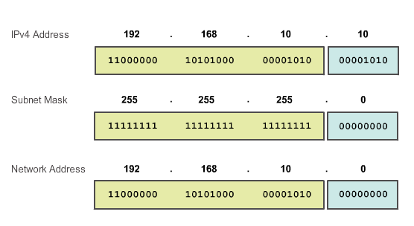
IPv4 Subnet Mask Bitwise AND Operation
1 AND 1 = 1 1 AND 0 = 0 0 AND 1 = 0 0 AND 0 = 0
Notes:
8.1.2.5 and 8.1.2.6 Bitwise AND Operation/Importance of ANDing

Slide 19
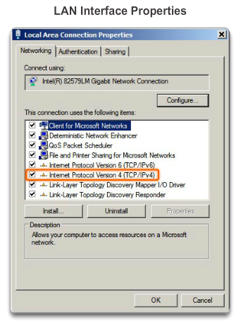
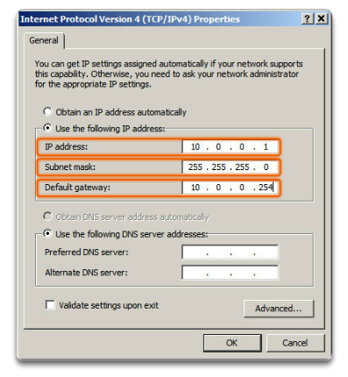
IPv4 Unicast, Broadcast, and Multicast Assigning a Static IPv4 Address to a Host
LAN Interface Properties
Configuring a Static IPv4 Address
Notes:
8.1.3.1 Assigning a Static IPv4 Address to a Host

Slide 20
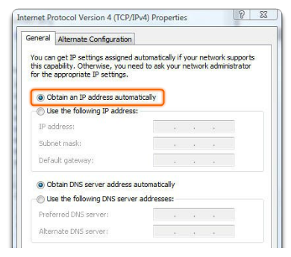
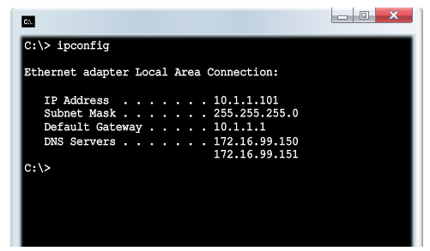
IPv4 Unicast, Broadcast, and Multicast Assigning a Dynamic IPv4 Address to a Host
Verification
DHCP – The preferred method of assigning IPv4 addresses to hosts on large networks because it reduces the burden on network support staff and virtually eliminates entry errors.
Notes:
8.1.3.2 Assigning a Dynamic IPv4 Address to a Host

Slide 21
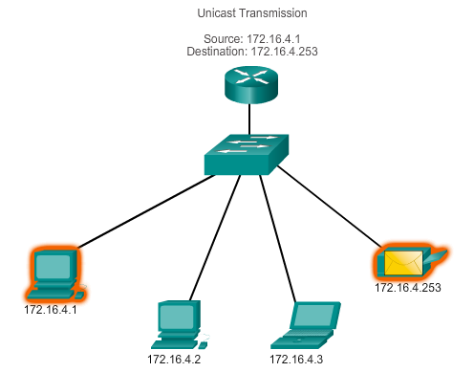
IPv4 Unicast, Broadcast, and Multicast Unicast Transmission
In an IPv4 network, the hosts can communicate one of three different ways:
Unicast, Broadcast, and Multicast
#1 Unicast – the process of sending a packet from one host to an individual host.

Slide 22
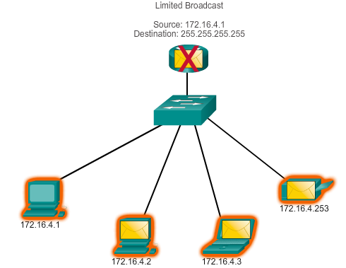
IPv4 Unicast, Broadcast, and Multicast Broadcast Transmission
In an IPv4 network, the hosts can communicate one of three different ways: Unicast, Broadcast, and Multicast.
#2 Broadcast – the process of sending a packet from one host to all hosts in the network.
Directed broadcast
Destination 172.16.4.255
Hosts within the 172.16.4.0/24 network
NOTE: Routers do not forward a limited broadcast!
Directed broadcast
Destination 172.16.4.255
Hosts within the 172.16.4.0/24 network

Slide 23
IPv4 Unicast, Broadcast, and Multicast Multicast Transmission
In an IPv4 network, the hosts can communicate one of three different ways: Unicast, Broadcast, and Multicast.
#3 Multicast – The process of sending a packet from one host to a selected group of hosts, possibly in different networks.
Reduces traffic
Reserved for addressing multicast groups – 224.0.0.0 to 239.255.255.255.
Link local – 224.0.0.0 to 224.0.0.255 (Example: routing information exchanged by routing protocols)
Globally scoped addresses – 224.0.1.0 to 238.255.255.255 (Example: 224.0.1.1 has been reserved for Network Time Protocol)

Slide 24
Types of IPv4 Address Public and Private IPv4 Addresses
Private address blocks are:
Hosts that do not require access to the Internet can use private addresses
10.0.0.0 to 10.255.255.255 (10.0.0.0/8)
172.16.0.0 to 172.31.255.255 (172.16.0.0/12)
192.168.0.0 to 192.168.255.255 (192.168.0.0/16)
Shared address space addresses:
Not globally routable
Intended only for use in service provider networks
Address block is 100.64.0.0/10

Slide 25
Types of IPv4 Address Special Use IPv4 Addresses
Network and Broadcast addresses – within each network the first and last addresses cannot be assigned to hosts
Loopback address – 127.0.0.1 a special address that hosts use to direct traffic to themselves (addresses 127.0.0.0 to 127.255.255.255 are reserved)
Link-Local address – 169.254.0.0 to 169.254.255.255 (169.254.0.0/16) addresses can be automatically assigned to the local host
TEST-NET addresses – 192.0.2.0 to 192.0.2.255 (192.0.2.0/24) set aside for teaching and learning purposes, used in documentation and network examples
Experimental addresses – 240.0.0.0 to 255.255.255.254 are listed as reserved

Slide 26
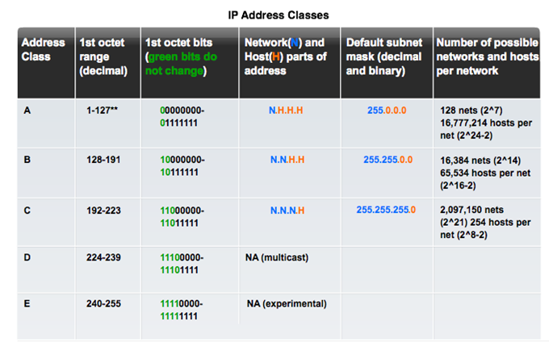
Types of IPv4 Address Legacy Classful Addressing
See if updated graphic with top row in text case for consistency.

Slide 27
Types of IPv4 Address Legacy Classful Addressing (cont.)
Classless Addressing
Formal name is Classless Inter-Domain Routing (CIDR, pronounced “cider
Created a new set of standards that allowed service providers to allocate IPv4 addresses on any address bit boundary (prefix length) instead of only by a class A, B, or C address
Notes:
8.1.4.4 Legacy Classful Addressing (cont.)

Slide 28
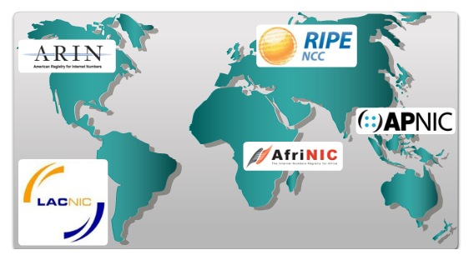
Types of IPv4 Address Assignment of IP Addresses
Regional Internet Registries (RIRs)

Slide 29
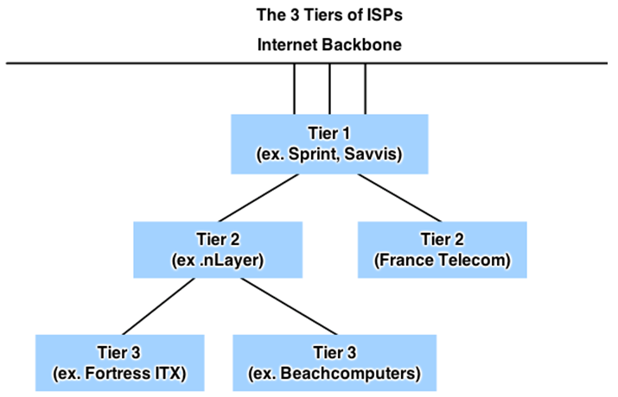
Types of IPv4 Address Assignment of IP Addresses (Cont.)
ISPs are large national or international ISPs that are directly connected to the Internet backbone.
Tier 2 ISPs generally focus on business customers.
Tier 3 ISPs often bundle Internet connectivity as a part of network and computer service contracts for their customers.
Tier 3 ISPs purchase their Internet service from Tier 2 ISPs.

Slide 30
7.2 IPv6 Network Addresses
Notes:
8.2 IPv6 Network Addresses

Slide 31
IPv4 Issues The Need for IPv6
IPv6 is designed to be the successor to IPv4.
Depletion of IPv4 address space has been the motivating factor for moving to IPv6.
Projections show that all five RIRs will run out of IPv4 addresses between 2015 and 2020.
With an increasing Internet population, a limited IPv4 address space, issues with NAT and an Internet of things, the time has come to begin the transition to IPv6!
IPv4 has a theoretical maximum of 4.3 billion addresses, plus private addresses in combination with NAT.
IPv6 larger 128-bit address space provides for 340 undecillion addresses.
IPv6 fixes the limitations of IPv4 and includes additional enhancements, such as ICMPv6.

Slide 32
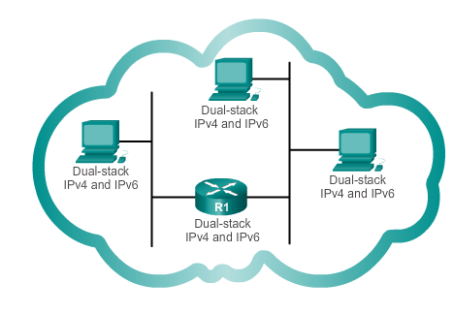
IPv4 Issues IPv4 and IPv6 Coexistence
The migration techniques can be divided into three categories:
Dual-stack, Tunnelling, and Translation.
Dual-stack
Dual-stack: Allows IPv4 and IPv6 to coexist on the same network. Devices run both IPv4 and IPv6 protocol stacks simultaneously.

Slide 33
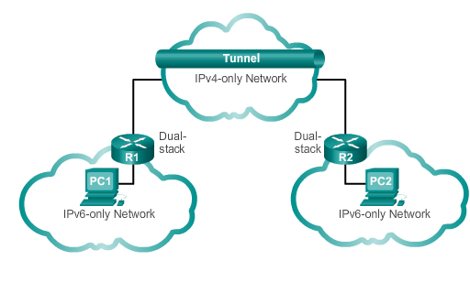
IPv4 Issues IPv4 and IPv6 Coexistence (cont.)
Tunnelling
Tunnelling: A method of transporting an IPv6 packet over an IPv4 network. The IPv6 packet is encapsulated inside an IPv4 packet.
Notes:
8.2.1.2 IPv4 and IPv6 Coexistence

Slide 34
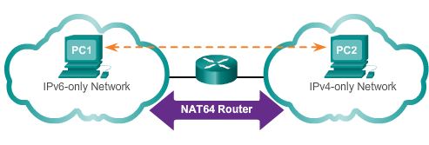
IPv4 Issues IPv4 and IPv6 Coexistence (cont.)
Translation
Translation: The Network Address Translation 64 (NAT64) allows IPv6-enabled devices to communicate with IPv4-enabled devices using a translation technique similar to NAT for IPv4. An IPv6 packet is translated to an IPv4 packet, and vice versa.
Notes:
8.2.1.2 IPv4 and IPV6 Coexistence (cont.)

Slide 35
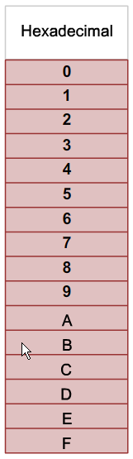
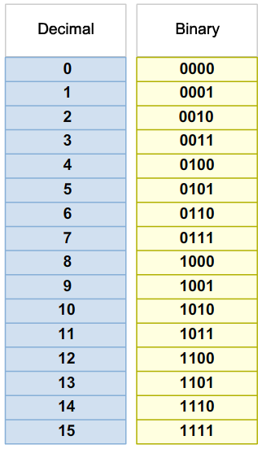
IPv6 Addressing Hexadecimal Number System
Hexadecimal is a base sixteen system.
Base 16 numbering system uses the numbers 0 to 9 and the letters A to F.
Four bits (half of a byte) can be represented with a single hexadecimal value.

Slide 36
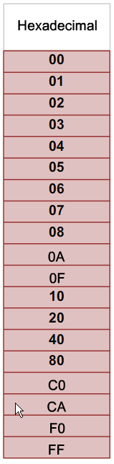
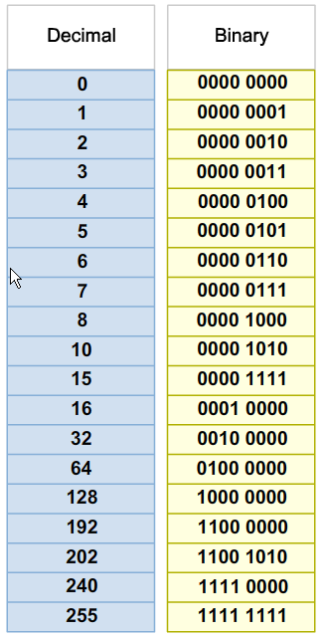
IPv6 Addressing Hexadecimal Number System (cont.)
Look at the binary bit patterns that match the decimal and hexadecimal values
Notes:
8.2.2.1 Hexadecimal Number System (cont.)

Slide 37
IPv6 Addressing IPv6 Address Representation
128 bits in length and written as a string of hexadecimal values
In IPv6, 4 bits represents a single hexadecimal digit, 32 hexadecimal value = IPv6 address
2001:0DB8:0000:1111:0000:0000:0000:0200
FE80:0000:0000:0000:0123:4567:89AB:CDEF
Hextet used to refer to a segment of 16 bits or four hexadecimals
Can be written in either lowercase or uppercase

Slide 38
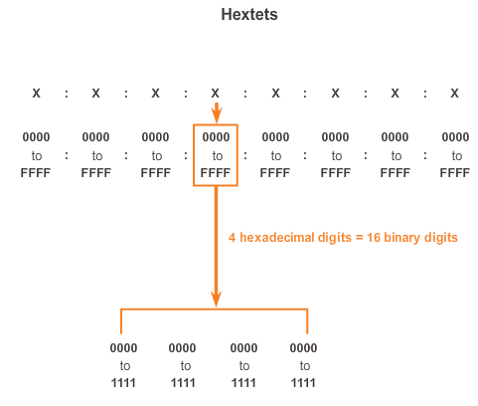
IPv6 Addressing IPv6 Address Representation (cont.)
Notes:
8.2.2.2 IPv6 Address Representation (cont.)

Slide 39

IPv6 Addressing Rule 1- Omitting Leading 0s
The first rule to help reduce the notation of IPv6 addresses is any leading 0s (zeros) in any 16-bit section or hextet can be omitted.
01AB can be represented as 1AB.
09F0 can be represented as 9F0.
0A00 can be represented as A00.
00AB can be represented as AB.
Notes:
8.2.2.3 Rule 1 – Omitting Leading 0s

Slide 40
IPv6 Addressing Rule 2 - Omitting All 0 Segments
A double colon (::) can replace any single, contiguous string of one or more 16-bit segments (hextets) consisting of all 0’s.
Double colon (::) can only be used once within an address otherwise the address will be ambiguous.
Known as the compressed format.
Incorrect address - 2001:0DB8::ABCD::1234.
Notes:
8.2.2.4 Rule 2 – Omitting All 0 Segments

Slide 41
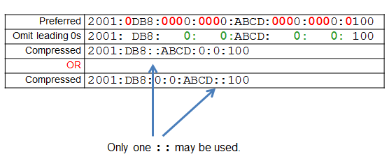
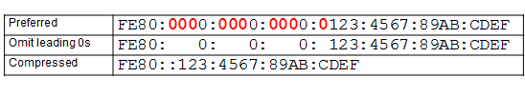
IPv6 Addressing Rule 2 - Omitting All 0 Segments (cont.)
Example #1
Example #2
Notes:
8.2.2.4 Rule 2 – Omitting All 0 Segments (cont.)

Slide 42
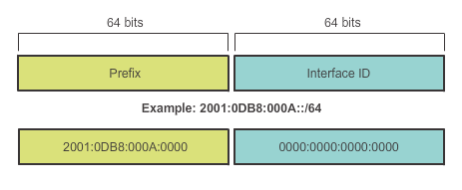
Types of IPv6 Addresses IPv6 Prefix Length
IPv6 does not use the dotted-decimal subnet mask notation
Prefix length indicates the network portion of an IPv6 address using the following format:
IPv6 address/prefix length
Prefix length can range from 0 to 128
Typical prefix length is /64

Slide 43
Types of IPv6 Addresses IPv6 Address Types
There are three types of IPv6 addresses:
Unicast
Multicast
Anycast.
Note: IPv6 does not have broadcast addresses.

Slide 44
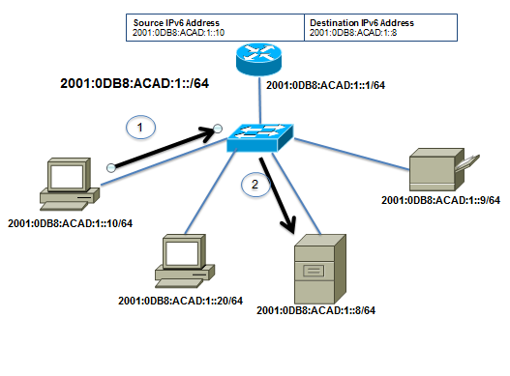
Types of IPv6 Addresses IPv6 Unicast Addresses
Unicast
Uniquely identifies an interface on an IPv6-enabled device.
A packet sent to a unicast address is received by the interface that is assigned that address.

Slide 45
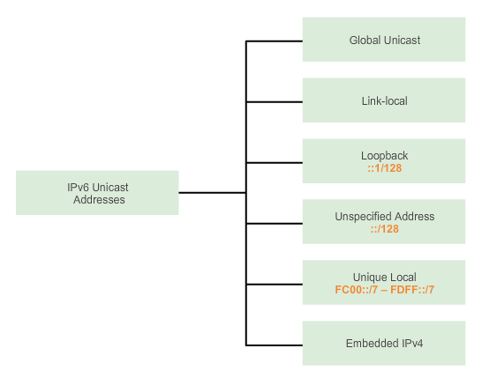
Types of IPv6 Addresses IPv6 Unicast Addresses (cont.)

Slide 46
Types of IPv6 Addresses IPv6 Unicast Addresses (cont.)
Global Unicast
Similar to a public IPv4 address
Globally unique
Internet routable addresses
Can be configured statically or assigned dynamically
Link-local
Used to communicate with other devices on the same local link
Confined to a single link; not routable beyond the link
Notes:
8.2.3.3 IPv6 Unicast Addresses (cont.)

Slide 47
Types of IPv6 Addresses IPv6 Unicast Addresses (cont.)
Loopback
Used by a host to send a packet to itself and cannot be assigned to a physical interface.
Ping an IPv6 loopback address to test the configuration of TCP/IP on the local host.
All-0s except for the last bit, represented as ::1/128 or just ::1.
Unspecified Address
All-0’s address represented as ::/128 or just ::
Cannot be assigned to an interface and is only used as a source address.
An unspecified address is used as a source address when the device does not yet have a permanent IPv6 address or when the source of the packet is irrelevant to the destination.
Notes:
8.2.3.3 IPv6 Unicast Addresses (cont.)

Slide 48
Types of IPv6 Addresses IPv6 Unicast Addresses (cont.)
Unique Local
Similar to private addresses for IPv4.
Used for local addressing within a site or between a limited number of sites.
In the range of FC00::/7 to FDFF::/7.
IPv4 Embedded (not covered in this course)
Used to help transition from IPv4 to IPv6.
Notes:
8.2.3.3 IPv6 Unicast Addresses (cont.)

Slide 49
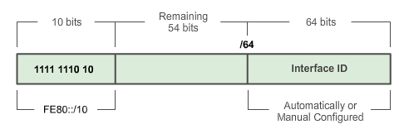
Types of IPv6 Addresses IPv6 Link-Local Unicast Addresses
Add a header
Every IPv6-enabled network interface is REQUIRED to have a link-local address
Enables a device to communicate with other IPv6-enabled devices on the same link and only on that link (subnet)
FE80::/10 range, first 10 bits are 1111 1110 10xx xxxx
1111 1110 1000 0000 (FE80) - 1111 1110 1011 1111 (FEBF)

Slide 50
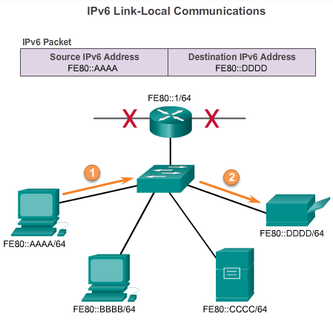
Types of IPv6 Addresses IPv6 Link-Local Unicast Addresses (cont.)
Packets with a source or destination link-local address cannot be routed beyond the link from where the packet originated.
Notes:
8.2.3.4 IPv6 Link-Local Unicast Addresses

Slide 51
IPv6 Unicast Addresses Structure of an IPv6 Global Unicast Address
IPv6 global unicast addresses are globally unique and routable on the IPv6 Internet
Equivalent to public IPv4 addresses
ICANN allocates IPv6 address blocks to the five RIRs
Notes:
8.2.4.1 Structure of an IPv6 Global Unicast Address

Slide 52
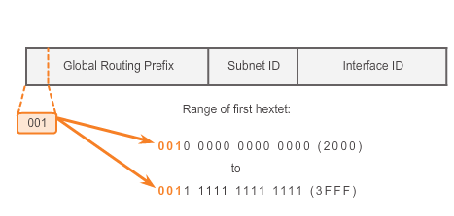
IPv6 Unicast Addresses Structure of an IPv6 Global Unicast Address (cont.)
Currently, only global unicast addresses with the first three bits of 001 or 2000::/3 are being assigned
Notes:
8.2.4.1 Structure of an IPv6 Global Unicast Address (cont.)

Slide 53
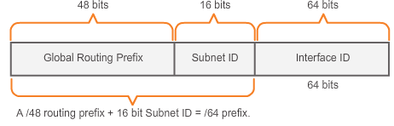
IPv6 Unicast Addresses Structure of an IPv6 Global Unicast Address (cont.)
A global unicast address has three parts: Global Routing Prefix, Subnet ID, and Interface ID.
Global Routing Prefix is the prefix or network portion of the address assigned by the provider, such as an ISP, to a customer or site, currently, RIR’s assign a /48 global routing prefix to customers.
2001:0DB8:ACAD::/48 has a prefix that indicates that the first 48 bits (2001:0DB8:ACAD) is the prefix or network portion.

Slide 54
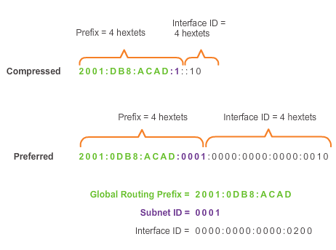
IPv6 Unicast Addresses Structure of an IPv6 Global Unicast Address (cont.)
Subnet ID is used by an organization to identify subnets within its site
Interface ID
Equivalent to the host portion of an IPv4 address.
Used because a single host may have multiple interfaces, each having one or more IPv6 addresses.
Notes:
8.2.4.1 Structure of an IPv6 Global Unicast Address

Slide 55
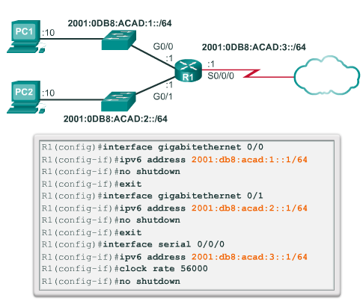
IPv6 Unicast Addresses Static Configuration of a Global Unicast Address
Notes:
8.2.4.2 Static Configuration of a Global Unicast Address

Slide 56
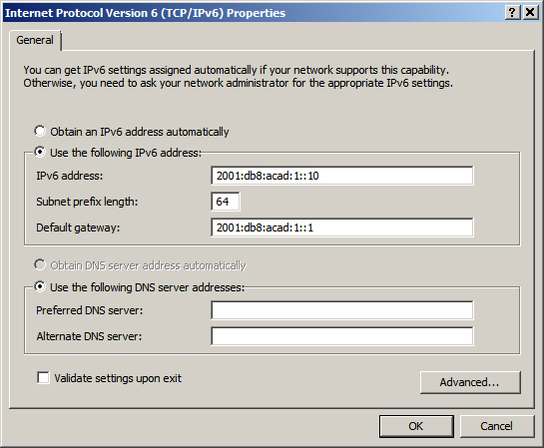
IPv6 Unicast Addresses Static Configuration of an IPv6 Global Unicast Address (cont.)
Windows IPv6 Setup
Notes:
8.2.4.2 Static Configuration of an IPv6 Global Unicast Address (cont.)

Slide 57
IPv6 Unicast Addresses Dynamic Configuration of a Global Unicast Address using SLAAC
Stateless Address Autoconfiguraton (SLAAC)
A method that allows a device to obtain its prefix, prefix length and default gateway from an IPv6 router
No DHCPv6 server needed
Rely on ICMPv6 Router Advertisement (RA) messages
IPv6 routers
Forwards IPv6 packets between networks
Can be configured with static routes or a dynamic IPv6 routing protocol
Sends ICMPv6 RA messages
Notes:
8.2.4.3 Dynamic Configuration of a Global Unicast Address using SLAAC

Slide 58
IPv6 Unicast Addresses Dynamic Configuration of a Global Unicast Address using SLAAC (cont.)
The IPv6 unicast-routing command enables IPv6 routing.
RA message can contain one of the following three options:
SLAAC Only – Uses the information contained in the RA message.
SLAAC and DHCPv6 – Uses the information contained in the RA message and get other information from the DHCPv6 server, stateless DHCPv6 (for example, DNS).
DHCPv6 only – The device should not use the information in the RA, stateful DHCPv6.
Routers send ICMPv6 RA messages using the link-local address as the source IPv6 address
Notes:
8.2.4.3 Dynamic Configuration of a Global Unicast Address using SLAAC (cont.)

Slide 59
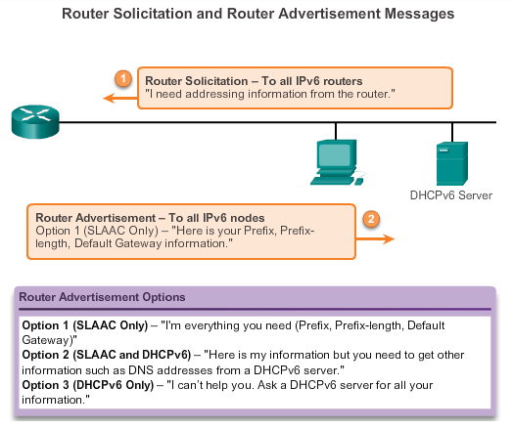
IPv6 Unicast Addresses Dynamic Configuration of a Global Unicast Address using SLAAC (cont.)
Notes:
8.2.4.3 Dynamic Configuration of a Global Unicast Address using SLAAC (cont.)

Slide 60
IPv6 Unicast Addresses Dynamic Configuration of a Global Unicast Address using DHCPv6 (cont.)
Dynamic Host Configuration Protocol for IPv6 (DHCPv6)
Similar to IPv4
Automatically receives addressing information, including a global unicast address, prefix length, default gateway address and the addresses of DNS servers using the services of a DHCPv6 server.
Device may receive all or some of its IPv6 addressing information from a DHCPv6 server depending upon whether option 2 (SLAAC and DHCPv6) or option 3 (DHCPv6 only) is specified in the ICMPv6 RA message.
Host may choose to ignore whatever is in the router’s RA message and obtain its IPv6 address and other information directly from a DHCPv6 server.
Notes:
8.2.4.4 Dynamic Configuration of a Global Unicast Address using DHCPv6 (cont.)

Slide 61
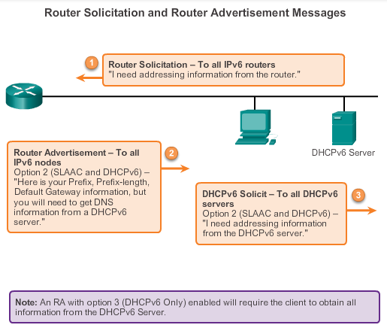
IPv6 Unicast Addresses Dynamic Configuration of a Global Unicast Address using DHCPv6 (cont.)
Notes:
8.2.4.4 Dynamic Configuration of a Global Unicast Address using DHCPv6 (cont.)

Slide 62
IPv6 Unicast Addresses EUI-64 Process or Randomly Generated
EUI-64 Process
Uses a client’s 48-bit Ethernet MAC address and inserts another 16 bits in the middle of the 46-bit MAC address to create a 64-bit Interface ID.
Advantage is that the Ethernet MAC address can be used to determine the interface; is easily tracked.
EUI-64 Interface ID is represented in binary and comprises three parts:
24-bit OUI from the client MAC address, but the 7th bit (the Universally/Locally bit) is reversed (0 becomes a 1).
Inserted as a 16-bit value FFFE.
24-bit device identifier from the client MAC address.
Notes:
8.2.4.5 EUI-64 Process or Randomly Generated

Slide 63
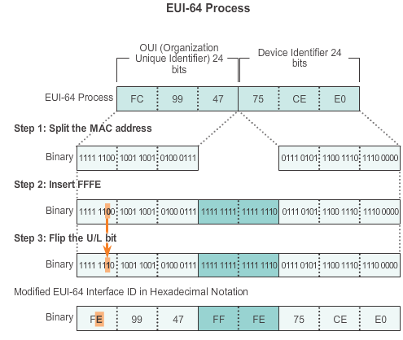
IPv6 Unicast Addresses EUI-64 Process or Randomly Generated (cont.)
Notes:
8.2.4.5 EUI-64 Process or Randomly Generated

Slide 64
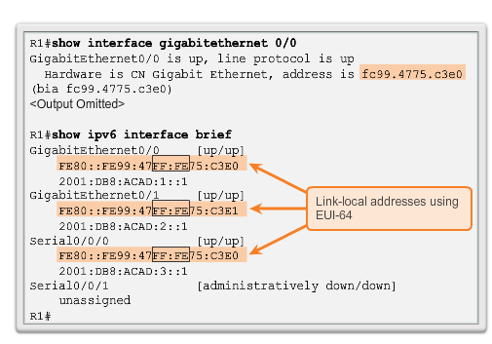
IPv6 Unicast Addresses EUI-64 Process or Randomly Generated (cont.)
Notes:
8.2.4.5 EUI-64 Process or Randomly Generated (cont.)

Slide 65
IPv6 Unicast Addresses EUI-64 Process or Randomly Generated (cont.)
Randomly Generated Interface IDs
Depending upon the operating system, a device can use a randomly generated Interface ID instead of using the MAC address and the EUI-64 process.
Beginning with Windows Vista, Windows uses a randomly generated Interface ID instead of one created with EUI-64.
Windows XP (and previous Windows operating systems) used EUI-64.

Slide 66
IPv6 Unicast Addresses Dynamic Link-local Addresses
Link-Local Address
After a global unicast address is assigned to an interface, an IPv6-enabled device automatically generates its link-local address.
Must have a link-local address that enables a device to communicate with other IPv6-enabled devices on the same subnet.
Uses the link-local address of the local router for its default gateway IPv6 address.
Routers exchange dynamic routing protocol messages using link-local addresses.
Routers’ routing tables use the link-local address to identify the next-hop router when forwarding IPv6 packets.
Notes:
Khi sử dụng SLAAC (SLAAC chỉ hoặc SLAAC với DHCPv6), một thiết bị nhận tiền tố và tiền tố của nó dài từ ICMPv6 RA. Bởi vì các tiền tố của địa chỉ đã được chỉ định bởi các thông điệp RA, điện thoại phải chỉ cung cấp các phần ID giao diện của địa chỉ của nó. Như đã nói trước đây, ID giao diện có thể được tự động tạo ra bằng cách sử dụng quá trình EUI-64, hoặc tùy thuộc vào hệ điều hành, tạo ra một cách ngẫu nhiên. Sử dụng thông tin từ thông điệp RA và ID giao diện, thiết bị có thể thiết lập địa chỉ unicast toàn cầu của mình. Sau một địa chỉ unicast toàn cầu được gán cho một giao diện, các thiết bị hỗ trợ IPv6 sẽ tự động tạo ra địa chỉ link-local của nó. IPv6 thiết bị phải có tối thiểu, địa chỉ link-local. Nhớ lại rằng một địa chỉ link-local IPv6 cho phép một thiết bị để giao tiếp với các thiết bị hỗ trợ IPv6 khác trên cùng một subnet. địa chỉ link-local IPv6 được sử dụng cho nhiều mục đích bao gồm: Một máy chủ sử dụng địa chỉ link-local của router địa phương cho địa chỉ IPv6 gateway mặc định của nó. Bộ định tuyến trao đổi thông điệp giao thức định tuyến động sử dụng địa chỉ link-local. bảng định tuyến router 'sử dụng địa chỉ link-local để xác định next-hop router khi chuyển tiếp các gói tin IPv6. Một địa chỉ link-local có thể được thiết lập tự động hoặc bằng tay cấu hình như một địa chỉ link-local tĩnh. Động giao Link-Local Địa chỉ Các địa chỉ link-local được tự động tạo ra bằng cách sử dụng FE80 :: / 10 tiền tố và ID giao diện. Theo mặc định, các router Cisco IOS sử dụng EUI-64 để tạo ra các giao diện ID cho tất cả các địa chỉ link-local trên giao diện IPv6. Đối với các giao diện nối tiếp, router sẽ sử dụng địa chỉ MAC của một giao diện Ethernet. Nhớ lại rằng một địa chỉ link-local phải là duy nhất chỉ có trên trang liên kết hoặc mạng. Tuy nhiên, một nhược điểm để sử dụng địa chỉ link-local động được giao là chiều dài của nó, mà làm cho nó khó khăn để xác định và ghi nhớ địa chỉ được giao.

Slide 67
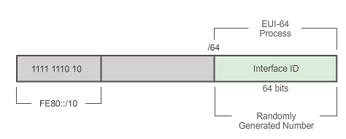
IPv6 Unicast Addresses Dynamic Link-local Addresses (cont.)
Dynamically Assigned
The link-local address is dynamically created using the FE80::/10 prefix and the Interface ID.
Notes:
8.2.4.6 Dynamic Link-local Addresses (cont.)

Slide 68
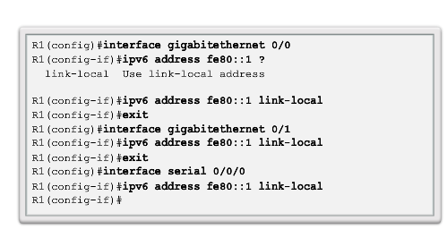
IPv6 Unicast Addresses Static Link-local Addresses
Configuring Link-local
Notes:
8.2.4.7 Static Link-local Addresses

Slide 69
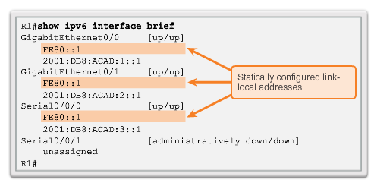
IPv6 Unicast Addresses Static Link-local Addresses (cont.)
Configuring Link-local
Notes:
8.2.4.7 Static Link-local Addresses (cont.)

Slide 70

IPv6 Global Unicast Addresses Verifying IPv6 Address Configuration
Each interface has two IPv6 addresses -
global unicast address that was configured
one that begins with FE80 is automatically added as a link-local unicast address
Notes:
8.2.4.8 Verifying IPv6 Address Configuration

Slide 71

IPv6 Global Unicast Addresses Verifying IPv6 Address Configuration (cont.)
Notes:
8.2.4.8 Verifying IPv6 Address Configuration (cont.)

Slide 72
IPv6 Multicast Addresses Assigned IPv6 Multicast Addresses
IPv6 multicast addresses have the prefix FF00::/8
There are two types of IPv6 multicast addresses:
Assigned multicast
Solicited node multicast

Slide 73
IPv6 Multicast Addresses Assigned IPv6 Multicast Addresses (cont.)
Two common IPv6 assigned multicast groups include:
FF02::1 All-nodes multicast group –
All IPv6-enabled devices join
Same effect as an IPv4 broadcast address
FF02::2 All-routers multicast group
All IPv6 routers join
A router becomes a member of this group when it is enabled as an IPv6 router with the ipv6 unicast-routing global configuration mode command.
A packet sent to this group is received and processed by all IPv6 routers on the link or network.
Notes:
8.2.5.1 Assigned IPv6 Multicast Addresses (cont.)

Slide 74

IPv6 Multicast Addresses Assigned IPv6 Multicast Addresses (cont.)
Notes:
8.2.5.1 Assigned IPv6 Multicast Addresses (cont.)

Slide 75

IPv6 Multicast Addresses Solicited Node IPv6 Multicast Addresses
Similar to the all-nodes multicast address, matches only the last 24 bits of the IPv6 global unicast address of a device
Automatically created when the global unicast or link-local unicast addresses are assigned
Created by combining a special FF02:0:0:0:0:0:FF00::/104 prefix with the right-most 24 bits of its unicast address

Slide 76
IPv6 Multicast Addresses Solicited Node IPv6 Multicast Addresses (cont.)
The solicited node multicast address consists of two parts:
FF02:0:0:0:0:0:FF00::/104 multicast prefix – First 104 bits of the all solicited node multicast address
Least significant 24-bits – Copied from the right-most 24 bits of the global unicast or link-local unicast address of the device
Notes:
8.2.5.2 Solicited Node IPv6 Multicast Addresses (cont.)

Slide 77
7.3 Connectivity Verification
Notes:
8.3 Connectivity Verification

Slide 78
ICMP ICMPv4 and ICMPv6 Messages
ICMP messages common to both ICMPv4 and ICMPv6 include:
Host confirmation
Destination or Service Unreachable
Time exceeded
Route redirection
Although IP is not a reliable protocol, the TCP/IP suite does provide for messages to be sent in the event of certain errors, sent using the services of ICMP.

Slide 79
ICMP ICMPv6 Router Solicitation and Router Advertisement Messages
ICMPv6 includes four new protocols as part of the Neighbor Discovery Protocol (ND or NDP):
Router Solicitation message
Router Advertisement message
Neighbor Solicitation message
Neighbor Advertisement message
Router Solicitation and Router Advertisement Message – Sent between hosts and routers.
Router Solicitation (RS) message – RS messages are sent as an IPv6 all-routers multicast message.
Router Advertisement (RA) message – RA messages are sent by routers to provide addressing information.

Slide 80

ICMP ICMPv6 Router Solicitation and Router Advertisement Messages (cont.)
Notes:
8.3.1.2 ICMPv6 Router Solicitation and Router Advertisement Messages (cont.)

Slide 81
ICMP ICMPv6 Neighbor Solicitation and Neighbor Advertisement Messages
Two additional message types:
Neighbor Solicitation (NS)
Neighbor Advertisement (NA) messages
Used for address resolution is used when a device on the LAN knows the IPv6 unicast address of a destination, but does not know its Ethernet MAC address.
Also used for Duplicate Address Detection (DAD)
Performed on the address to ensure that it is unique.
The device sends an NS message with its own IPv6 address as the targeted IPv6 address.

Slide 82

ICMP ICMPv6 Neighbor Solicitation and Neighbor Advertisement Messages (cont.)
Notes:
8.3.1.3 ICMPv6 Neighbor Solicitation and Neighbor Advertisement Messages (cont.)

Slide 83

Testing and Verification Ping – Testing the Local Stack

Slide 84

Testing and Verification Ping – Testing Connectivity to the Local LAN

Slide 85

Testing and Verification Ping – Testing Connectivity to Remote

Slide 86
Testing and Verification Traceroute – Testing the Path
Traceroute
Generates a list of hops that were successfully reached along the path.
Provides important verification and troubleshooting information.
If the data reaches the destination, then the trace lists the interface of every router in the path between the hosts.
If the data fails at some hop along the way, the address of the last router that responded to the trace can provide an indication of where the problem or security restrictions are found.
Provides round-trip time for each hop along the path and indicates if a hop fails to respond.

Slide 87
IP Addressing Summary
IP addresses are hierarchical with network, subnetwork, and host portions.
An IP address can represent a complete network, a specific host, or the broadcast address of the network.
The subnet mask or prefix is used to determine the network portion of an IP address. Once implemented, an IP network needs to be tested to verify its connectivity and operational performance.
DHCP enables the automatic assignment of addressing information such as IP address, subnet mask, default gateway, and other configuration information.
Notes:
Summary

Slide 88
IP Addressing Summary (cont.)
IPv4 hosts can communicate one of three different ways: unicast, broadcast, and multicast.
The private IPv4 address blocks are: 10.0.0.0/8, 172.16.0.0/12, and 192.168.0.0/16.
The depletion of IPv4 address space is the motivating factor for moving to IPv6.
Each IPv6 address has 128 bits verses the 32 bits in an IPv4 address.
The prefix length is used to indicate the network portion of an IPv6 address using the following format: IPv6 address/prefix length.
Notes:
Summary

Slide 89
IP Addressing Summary (cont.)
There are three types of IPv6 addresses: unicast, multicast, and anycast.
An IPv6 link-local address enables a device to communicate with other IPv6-enabled devices on the same link and only on that link (subnet).
Packets with a source or destination link-local address cannot be routed beyond the link from where the packet originated.
IPv6 link-local addresses are in the FE80::/10 range.
ICMP is available for both IPv4 and IPv6.
Notes:
Summary

Slide 90


